Slide 1

Chapter 8
Enterprise Information Systems
Turban, Aronson, and Liang Decision Support Systems and Intelligent Systems, Seventh Edition

Slide 2
Learning Objectives
Learn the basic concepts in enterprise information systems.
Determine how to extract information needs for a DSS.
Compare features and capabilities of EIS and DSS.
Learn the relationship between and amongst business intelligence/DSS systems.
Understand the capabilities of enterprise information portals.
Examine supply chain management issues.
Discuss customer relationship management concepts.
Understand how the Web impacts EIS, and vice versa.
Describe how EIS has improved decision making.
Learn emerging and future EIS.

Slide 3
United States Military Turns to Portals Vignette
Implement Web-based portals to enhance communications
Allows quick dispersal of combat intelligence
Improve quality of life issues
Connect support applications with tactical applications

Slide 4
Enterprise Information Systems
Executive information system
  Computer system that allows executives access to management reports
    Drill-down capabilities
    User-friendly
Executive support systems
  Comprehensive executive support system
    Includes communication, office automation, analysis support, business intelligence
Enterprise information systems
  Corporate-wide system
  Not restricted to executives
  Business intelligence

Slide 5
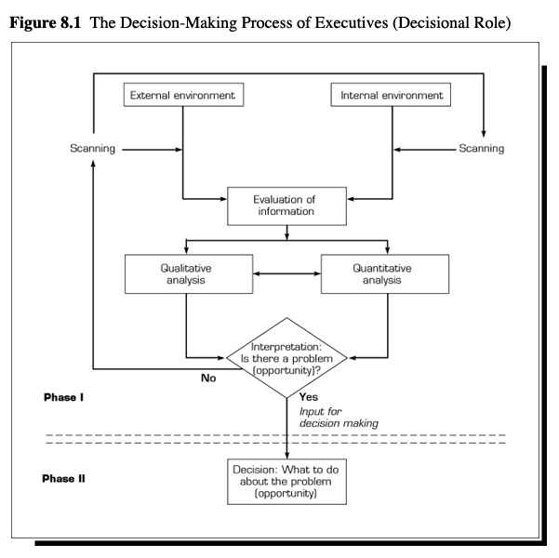
Information Flows
Internal information from functional units
External information from Internet, news media, government
  Environmental scanning

Slide 6
Capabilities of Enterprise Information System
Drill-down paths
  Supported by star or snowflake schemas
Critical success factors
  Strategic, managerial, or operational
  Sources: organizational, industrial, environmental
  Types of information monitored:
    Key problem narratives
    Highlight charts
    Top level financials
    Key factors
    Detailed key performance indicator responsibility reports

Slide 7
Capabilities of Enterprise Information System, continued
Status Access
  Relevance of latest data of key indicators
Analysis
  Built-in analytical functions
  Integration with DSS products
  Analysis by intelligent agents
Exception reporting
  Management by exception to standards
Navigation of information
  Large amounts of data can be analyzed
Audio and Visual
  Use of colors and sounds
Communications
  E-mail, GSS, news groups, interface with voice mail

Slide 8
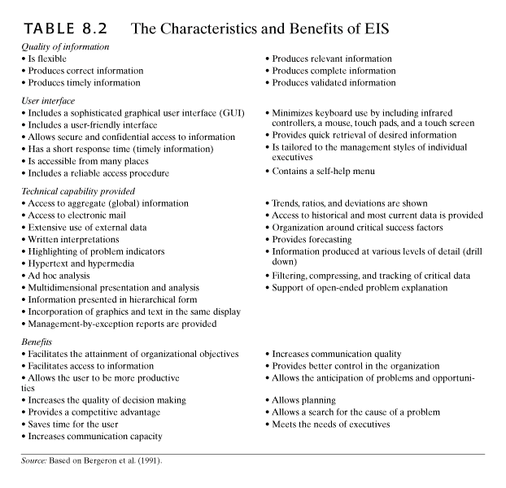

Slide 9
Comparing EIS to DSS
EIS
  Supports upper management in discovering problems and opportunities
  Repetitive analysis
  High speed
  GUI based
DSS
  Analyzes specific problem or opportunity
  Ad hoc analysis
  Effective
  May have GUI
Integration
  Uses EIS output to launch DSS
    Data from same places
  Integrates user roles
  Third party software

Slide 10
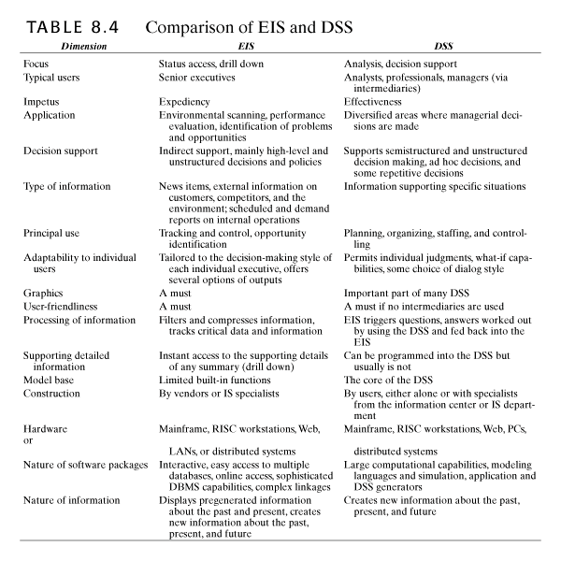

Slide 11
EIS Data Access and Use
Data usually comes from single warehouse
  Advanced data visualization
  Combines multidimensional analysis with OLAP
    Spreadsheets and graphics
    Slice and dice
    Web ready

Slide 12
Enterprise Portals
Corporate portals
    Integrate internal and external applications
    Web-based interface
    Effective distribution of information
    Encourage collaboration
    Data visualization tools
    Customized
    Search engines

Slide 13
Soft Information
Information for questionable sources that is used informally
  Vague
  Unofficial
  News reports and external data sources
  Predictions and speculations
  Explanations and justifications
  Opinions and gut feelings
  Rumors and hearsay

Slide 14
Organizational Decisional Support Systems
Focused on organizational task or activity
  affects several units
Cuts across hierarchy layers
Cuts across functional groups
Computer based
Communication technology
Can be integrated into a DSS or EIS

Slide 15
Supply Chains
Old
  Supply chain
    Material flow from sources to finished product and disbursement within the organization
  Demand chain
    Order generation, taking, and fulfillment
New
  Flow of material, information, services from suppliers through manufacturer to end user
Supply chain management
  Planning, organization, and coordination of supply chain activities
    Increase effectiveness
    Reduce risk
    Decrease cycle time
    Improve customer service

Slide 16
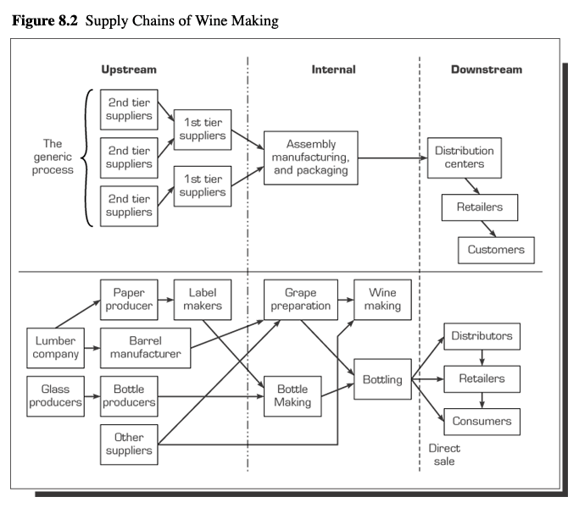
Supply Chains
Upstream = suppliers
Internal supply chain = changing inputs to outputs
Downstream = distribution

Slide 17
Value Chains
Porter’s value chain model
  Primary activities
    Inbound logistics
    Operations
    Outbound logistics
    Marketing and sales
    Customer service
  Support activities
    Organization’s infrastructure
    Human resource management
    Technology development
    Procurement

Slide 18
Value System
Value chain is part of larger stream called value system
  Includes tiers of suppliers
  Value chains of distributors
  Buyers
  Extended supply chain
  Maximize and optimize total value of chain

Slide 19
Supply Chain Problems
Uncertainties
  Demand forecasts
  Delivery time
  Quality issues
Need to coordinate activities
Other issues
  Poor customer service
  Obtaining real time data on chain status
  Cultural problems

Slide 20
Supply Chain Problem Solutions
Solutions
  Inventory management
  Shipping management
  Efficient purchasing
  JIT
  CRM
  Collaboration along chain
  Strategic partnerships
  Reduce number of intermediaries
  Outsourcing

Slide 21
Material Resource Planning
MRP system
  Production plan for 100% capacity
    Inventory models
    Master production schedule
    Component lists
CRP system
  Added factory and machine capacities
MRPII system
  Added financial and resource planning

Slide 22
Integration
Tangible benefits:
  Inventory reduction
  Personnel reduction
  Improved productivity
  Cost reductions
  Increased revenues
  Delivery improvement
  Order management
  Reduction in maintenance
Intangible benefits:
  Visibility of information
  Improved processes
  Better customer service
  Standardization
  Flexibility
  Globalization
  Improved employee satisfaction
  Increased business performance

Slide 23
Enterprise Resource Planning
ERP
  Computer system that integrates all of an organization’s departments and functions
    Shortens production times
    Based on value chain view
    Decreases costs in chain
    Expensive
    Increases customer service
    Single interface
    Facilitates business process changes
    Automates key business processes
  SCM provides intelligent decision support
    Overlay ERP
    Advanced planning and scheduling modules

Slide 24
Enterprise Resource Planning
Options
  Build your own
  Off-the-shelf packages
  Outsource
    Application Service Providers
Problems
  High failure rate
  ERP is a formal business process
  Organization’s processes don’t match the ERP’s
  Software capability and needs vary

Slide 25
Customer Resource Management Systems (CRM)
Enterprise approach
Communication based
Focused on:
  Customer acquisition
  Customer retention
  Customer loyalty
  Customer profitability
Empowers employees
Enables one-to-one marketing
Allows for proper allocation of resources to each customer class

Slide 26
CRM
Relationship technologies
  Data warehouses
  Foundation for CRM
  Business intelligence/business analytics
    Data mining
    Predictive analytics determine relationships
    OLAP
    Integrated with:
      GIS = geographical preferences
      Revenue management optimization software = optimized pricing
      Data mining workbench = targets promotions

Slide 27
CRM
Benefits:
  Decrease expense of recruiting customer
  Reduce sales costs
  Greater profitability through targeting and segmentation
  Increase customer retention
  Increase customer loyalty
  Improve customer service
  Customer-focused
Issues:
  Failure to use software
  Integration
  Organizational culture
  Expensive
  Adapting business processes
  Retention of employees
  Training
  Allocation of time for deployment
  Commitment from top management

Slide 28
CRM
Success
  Often intangible
    Improved customer satisfaction
  Tangible
    Reduced reporting cycle
    Reduced expense of doing business
    Reduced sales cycle
    Increased productivity
    Increased sale
Indications
  Systems used to meet key customer needs
  Make in-depth analysis of customer costs and potential profits
  Information linked from disparate business units
  Employees empowered to handle customers’ problems

Slide 29
Product Lifecycle Management (PLM)
Integrated, information driven
Includes all aspects of product’s life
Goals
  Streamline development
  Increase innovation
Requires integration of independent databases
Shares information about product among different groups, both inside and outside organization

Slide 30
PLM
Tracks electronic information about life of product
Links together all required processes
Integrates nodules and tools into single application suite
  Enhances communication and collaboration
  Product data is central component
  Repository
    Specifications, requirements, design documents, manufacturing plans, and support
    Available to all stakeholders at all times

Slide 31
PLM
Benefits:
  Flexibility
  Reduced change orders
  Improved design
  Reduced production times
  Reduced time to market
  Improved quality control
  Collaboration
  Centralized repository
Issues:
  Support from senior management
  User involvement
  Training
  Integration

Slide 32
Business Process Management Systems (BPM)
Integrates data, applications, and people through business process
Streamlined
Automates processes
Less administration
Graphical map of processes
Enterprise information portal into business processes
  Integrates systems
  Provides view of organization’s health and progress
  Unifies rules, processes, methods, and workflows
Benefits
  Links legacy systems to newer workflows
Issues
  Forces review of processes

Slide 33
Business Activity Monitoring Systems (BAM)
Real time systems monitoring specific facility
Detects opportunities, problems, and threats
  Modeling function for solutions
  Collaboration
  Fast response
Benefits
  Recognizing and responding to events
  Allows for quick resolution
Issues
  Senior management support
  Change in business processes
  Requires identification of CSFs and proper analytical techniques

Slide 34
Frontline Decision Support Systems
Frontline decision-making
  Automate decision processes and push them down the organization or out to partners
    Empowers employees
  Incorporates decision-making into daily work
    Provides right questions to ask
    Locates needed data
    Provides metrics for use with data

Slide 35
Future Developments
Hardware and software advances
Virtual reality
Three-dimensional image displays
Increased utilization of multimedia
Increased collaboration
Improved communication
Automated support
Intelligent agents

